Slide 1
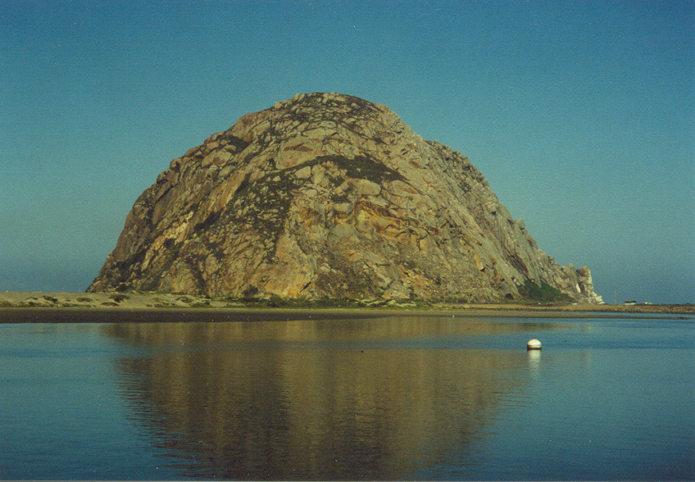
5.4: Fundamental Theorem of Calculus Part I (FTC pt. II)
Morro Rock, California
Photo by Vickie Kelly, 1998
Greg Kelly, Hanford High School, Richland, Washington

Slide 2
Time to Discover
We are going to discover the Fundamental Theorem of Calculus just like Newton and Leibniz

Slide 3
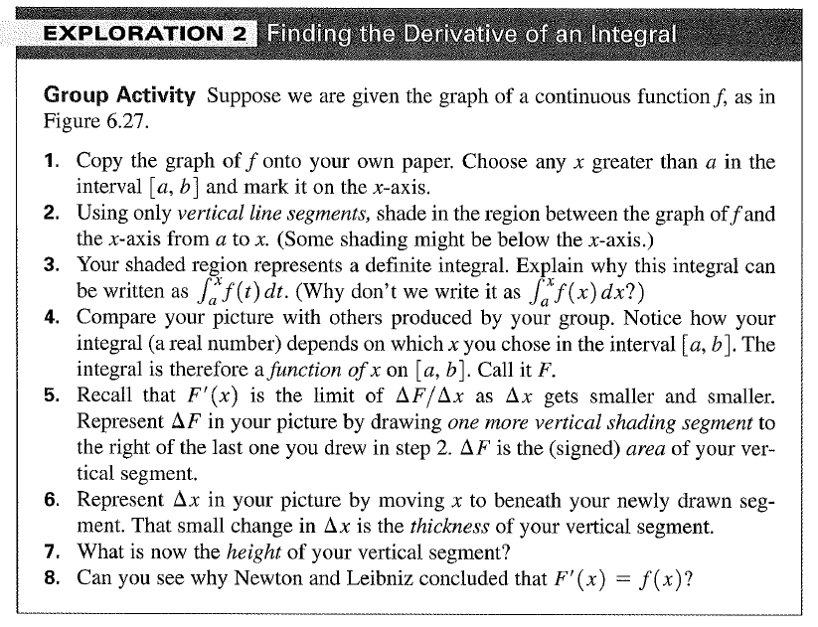

Slide 4
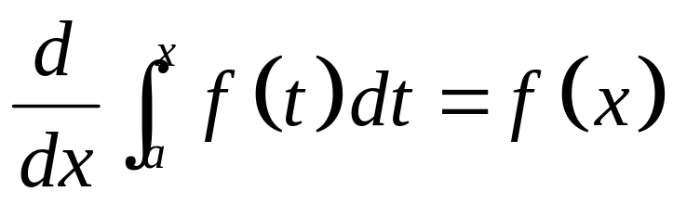

Here is my favorite calculus textbook quote of all time, from CALCULUS by Ross L. Finney and George B. Thomas, Jr., ©1990.
If you were being sent to a desert island and could take only one equation with you,
might well be your choice.

Slide 5
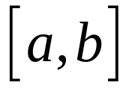
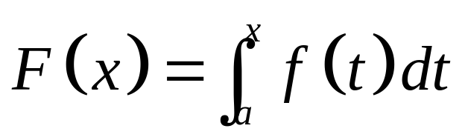
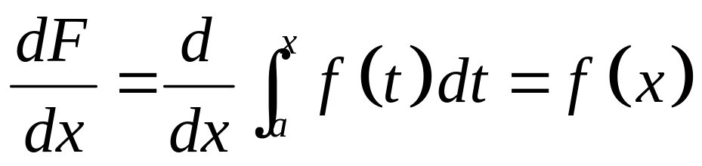
The Fundamental Theorem of Calculus, Part 1
If f is continuous on , then the function
has a derivative at every point in , and

Slide 6
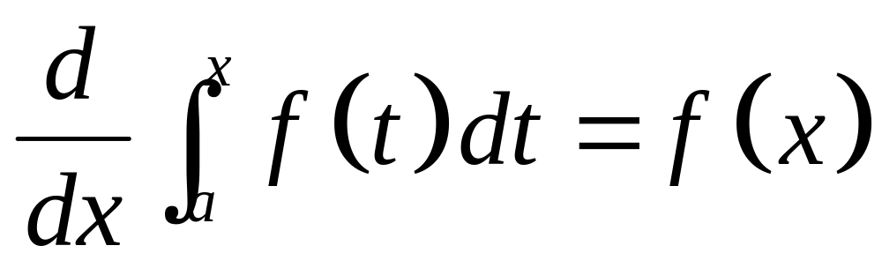
First Fundamental Theorem:
1. Derivative of an integral.

Slide 7
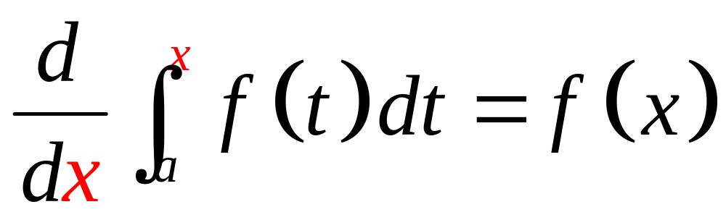
First Fundamental Theorem:
1. Derivative of an integral.
2. Derivative matches upper limit of integration.

Slide 8
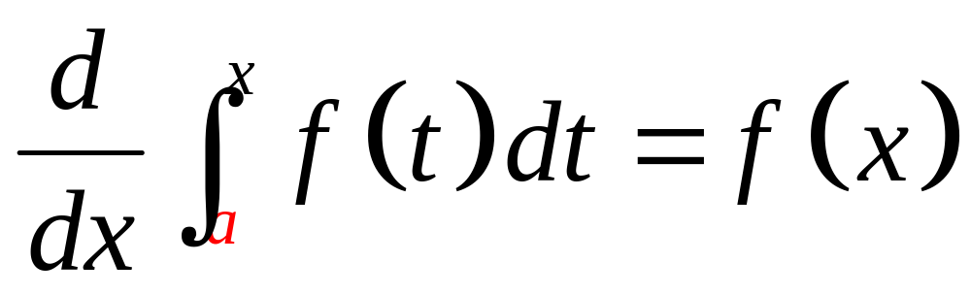
First Fundamental Theorem:
1. Derivative of an integral.
2. Derivative matches upper limit of integration.
3. Lower limit of integration is a constant.

Slide 9
First Fundamental Theorem:
New variable.
1. Derivative of an integral.
2. Derivative matches upper limit of integration.
3. Lower limit of integration is a constant.

Slide 10
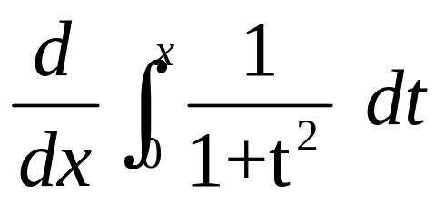
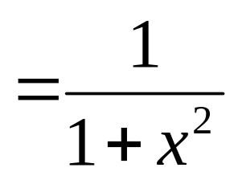
1. Derivative of an integral.
2. Derivative matches upper limit of integration.
3. Lower limit of integration is a constant.

Slide 11

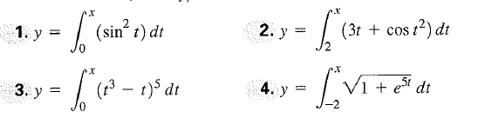
Notes:
Make sure to do this so they get the basic idea, plus you are doing two days on ftc anyways

Slide 12
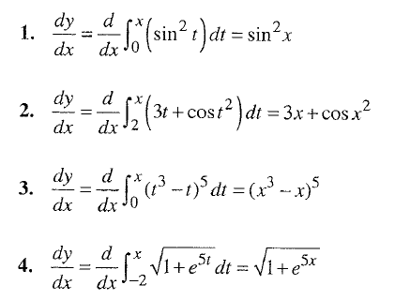
Notes:
Skip for more time on harder ones

Slide 13
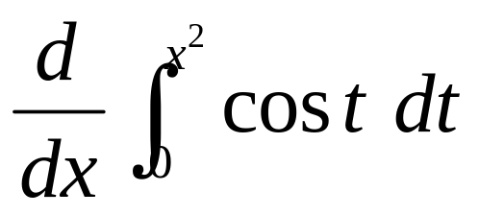
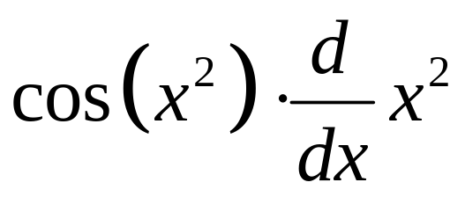
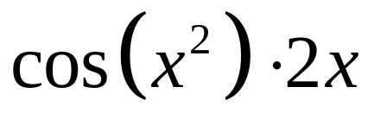
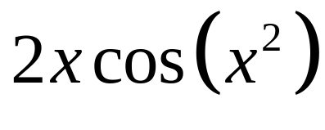
The upper limit of integration does not match the derivative, but we could use the chain rule.

Slide 14

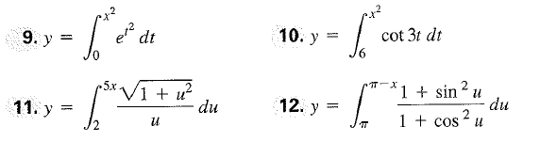
Notes:
Do these

Slide 15
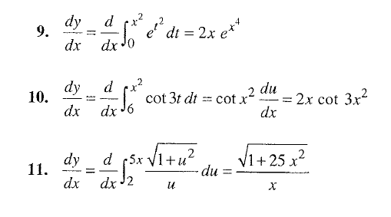
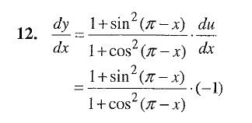
Notes:
Do these

Slide 16
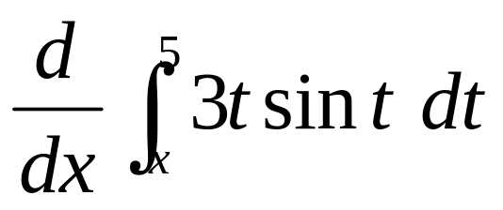
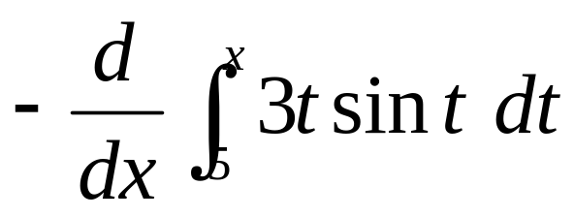
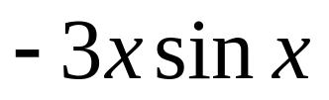
The lower limit of integration is not a constant, but the upper limit is.
We can change the sign of the integral and reverse the limits.

Slide 17



Notes:
Do these since mix of normal and chain

Slide 18
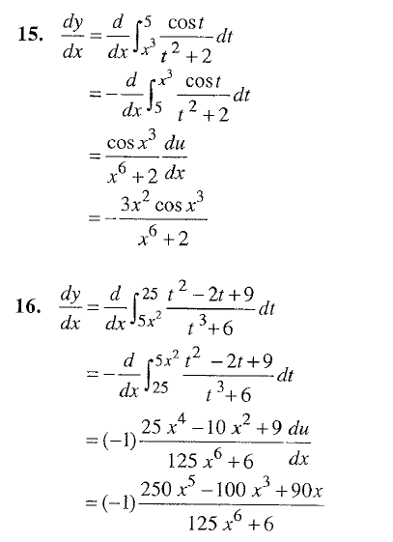
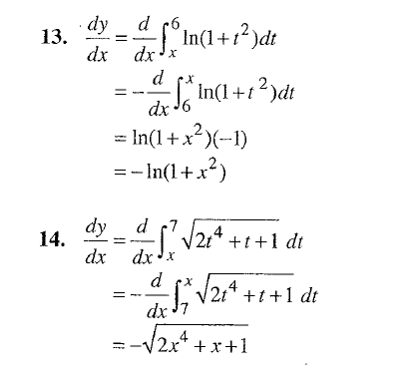
Notes:
Do these since mix of normal and chain

Slide 19
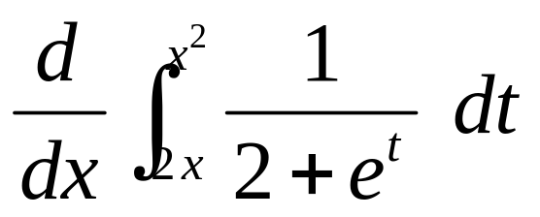
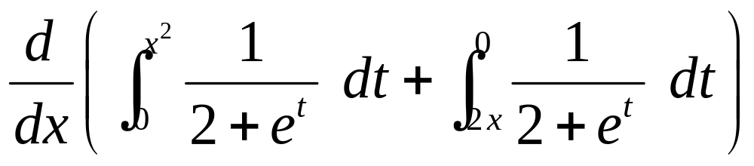
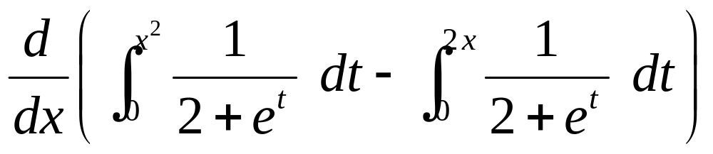
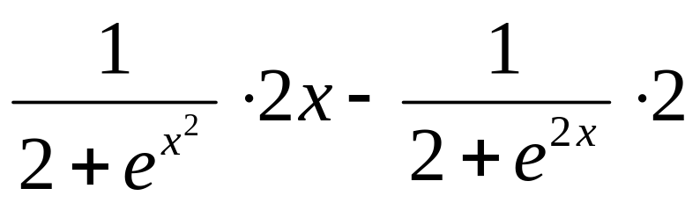
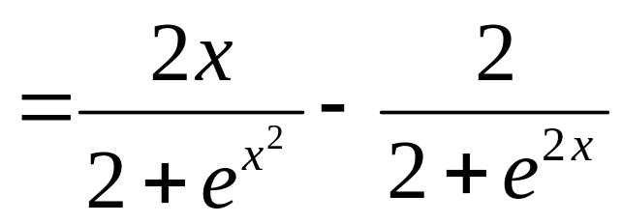
Neither limit of integration is a constant.
We split the integral into two parts.
It does not matter what constant we use!
(Limits are reversed.)
(Chain rule is used.)
Notes:
Skip this for time with FR

Slide 20
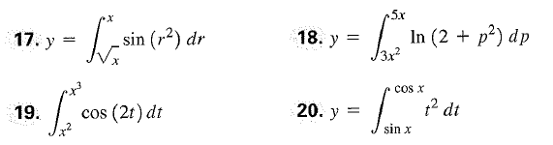
Notes:
Skip this to make room for FR

Slide 21
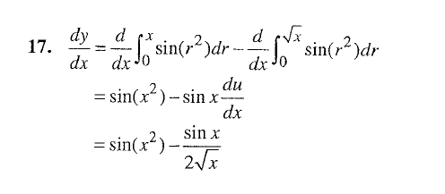
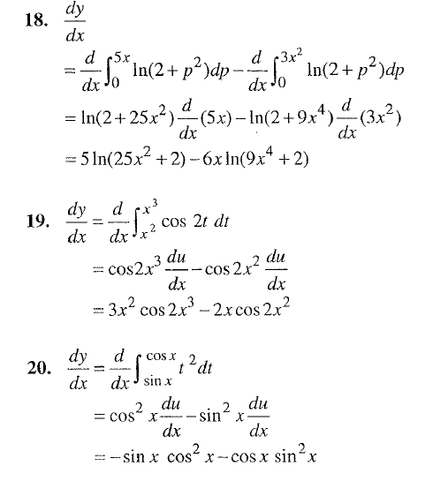
Notes:
Skip to make room for FR

Slide 22
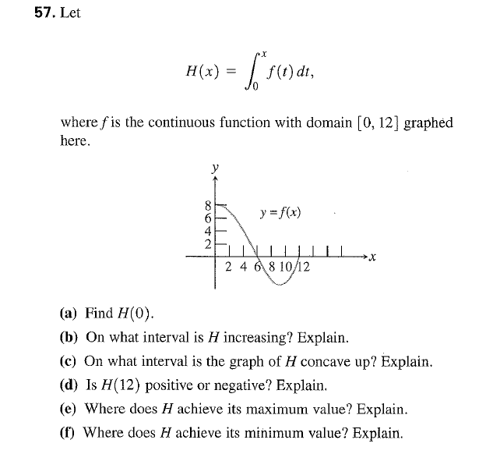
Notes:
Homework?

Slide 23
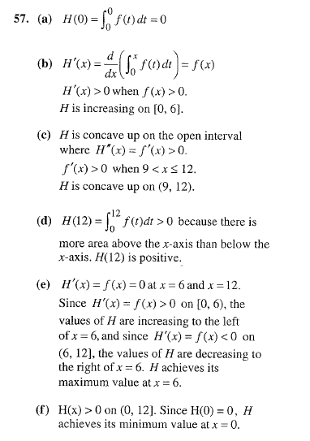

Slide 24
5.3: Fundamental Theorem of Calculus Part II (FTC pt. I)
FTC Day 2!

Slide 25
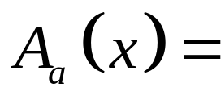



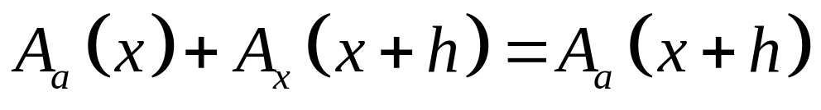
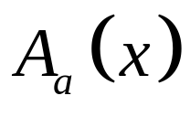
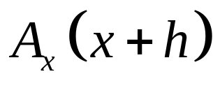
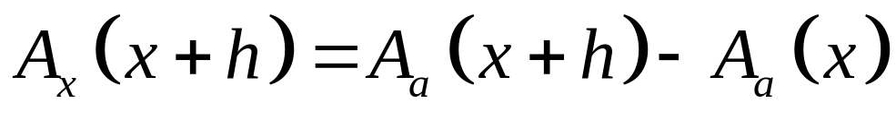
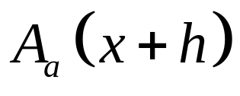
Let’s look at it another way:
Let area under the curve from a to x.
(“a” is a constant)
Then:

Slide 26
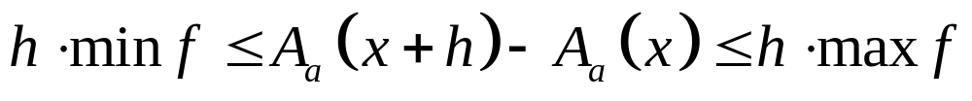
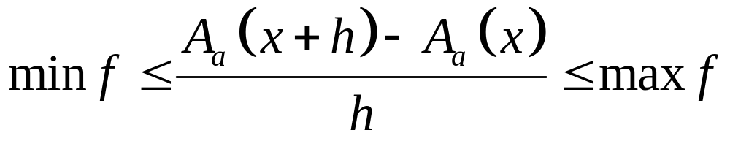
The area of a rectangle drawn under the curve would be less than the actual area under the curve.
min f
max f
The area of a rectangle drawn above the curve would be more than the actual area under the curve.
h

Slide 27
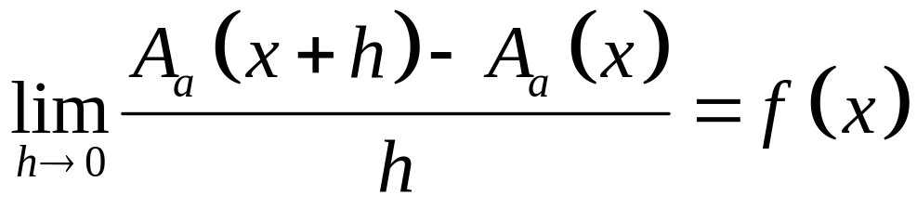
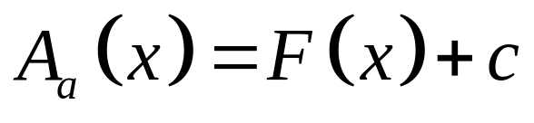

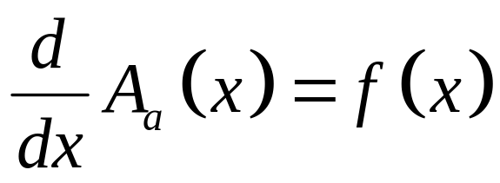
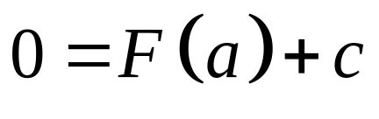
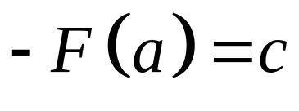
As h gets smaller, min f and max f get closer together.
This is the definition of derivative!
initial value
Take the anti-derivative of both sides to find an explicit formula for area.

Slide 28
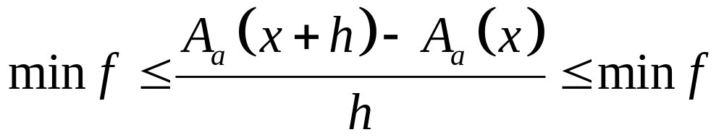
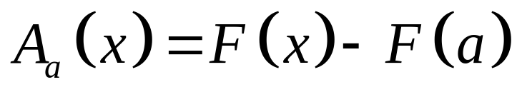
As h gets smaller, min f and max f get closer together.
Area under curve from a to x = antiderivative at x minus antiderivative at a.

Slide 29

The Fundamental Theorem of Calculus, Part 2
If f is continuous at every point of , and if F is any antiderivative of f on , then
(Also called the Integral Evaluation Theorem)
π

Slide 30

Now You Try!
(Integrate without your calculator!)

Slide 31






Slide 32

Now you try!

Slide 33






Slide 34
5.4 FTC (deriv. of int.)
Pg. 320: #21, #29 – 31 all, #45
Notes:
Assign after they have had the practice lesson

Slide 35
5.3 FTC (eval. Int.)
Pg. 314-315: #13, #17, #25, #33, #59
#59 is hard, so use the hint and FTC pt. 2
Please solve these without a calculator
Please make sure you have the unit circle memorized as well as basic exponential or log values memorized!

